Slide 1
NutriCoach
A Chatbot For Personalized Nutritional Guidance & Meal
Planning

Slide 2





Meet our team
Section: 001
Group No.: 3
DEEP Sheta
Kaveri Patel
Tirthak bhingaradiya
AKASH SHah
RAJAT singh RAWAT

Slide 3
OUTLINE
INTRODUCTION & PROBLEM STATEMENT
PROPOSED SOLUTION
USE CASE & RESULTS
LIMITATIONS & AREAS OF GROWTH
FAILURES & CHALLENGES
ETHICAL IMPLICATIONS OF AI

Slide 4
BACKGROUD STATEMENT
In today's fast-paced world where people are always on the go maintaining a healthy diet can be challenging
A healthy diet is important for good health, reducing the risk of chronic diseases like obesity, heart disease, stroke, diabetes, and improving overall well-being.
However, people often struggle to make healthy choices due to a lack of knowledge about nutrition, busy schedules, and conflicting dietary advice.

Slide 5
PROBLEM STATEMENT
There is an abundance of information available on the internet about healthy eating, but it can be confusing and misleading.
Additionally, people often have busy schedules and find it difficult to make time for meal planning and cooking healthy meals.
This can lead to a reliance on fast food and unhealthy processed foods, which can contribute to weight gain and poor health outcomes.
The main problem this project aims to solve is the lack of knowledge and guidance that people have when it comes to making healthy food choices.

Slide 6
PROJECT PROPOSAL
Our conversational AI-based chatbot can offer personalized nutritional guidance and meal planning ideas to help users make healthy food choices.
The chatbot will understand user preferences, dietary restrictions, and nutritional needs.
It will provide users with nutritional advice and recommendations for healthy meals and snacks.
This solution can be particularly useful for individuals who are looking to lose weight or manage chronic diseases such as diabetes or heart disease.

Slide 7
Here is a use case,
One girl is a 30-year-old who is trying to lose weight and eat healthier. She has a busy job and finds it difficult to make time for meal planning and cooking healthy meals.
She is also confused about what foods to eat and how much to eat to reach her goals. She decides to use an our NUTRIBOT to help herself with meal planning and nutritional guidance.
She opens the chatbot and tells it about her goals to lose weight and eat healthier. She also shares her dietary preferences, food allergies, and daily schedule.
The chatbot asks her about her age and more about dietary preferences and food allergies.

Slide 8
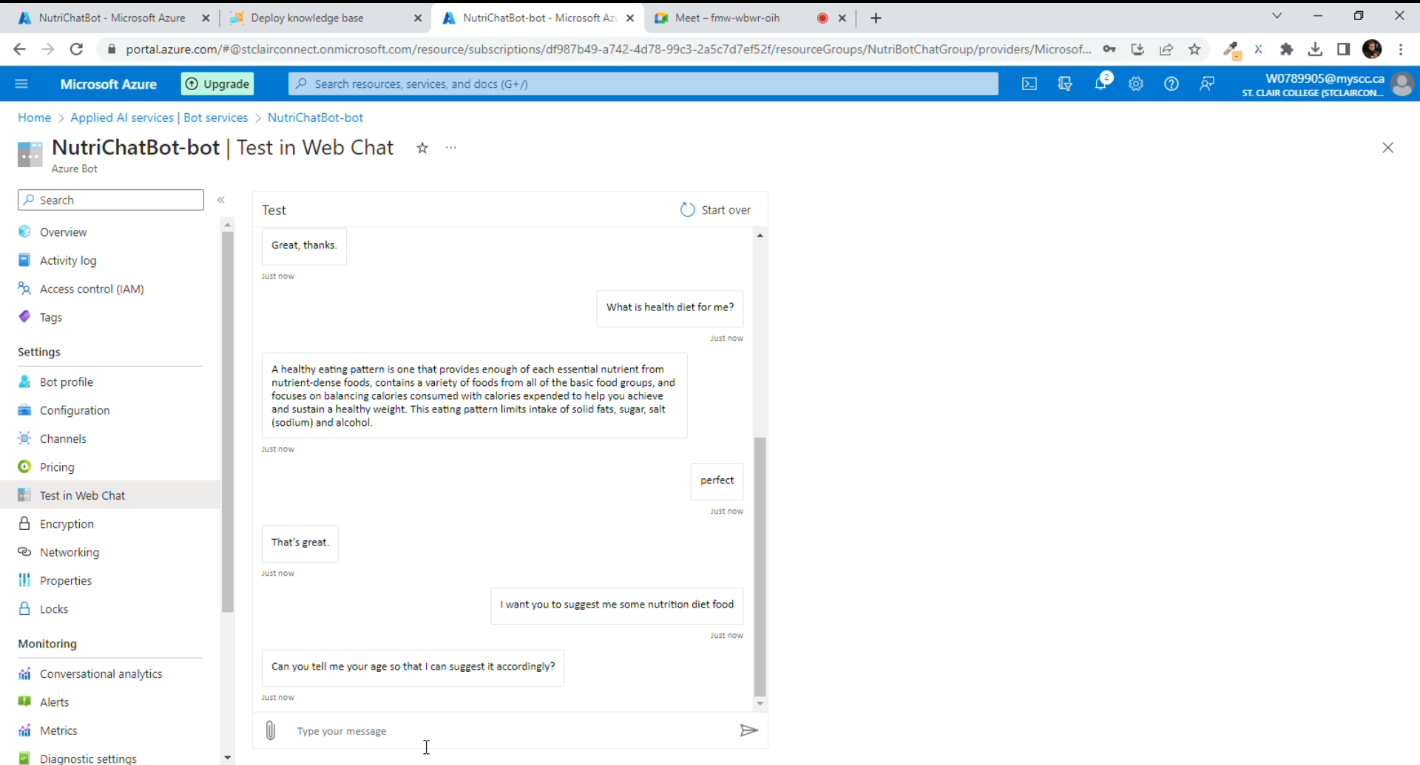
Here is a use case,

Slide 9
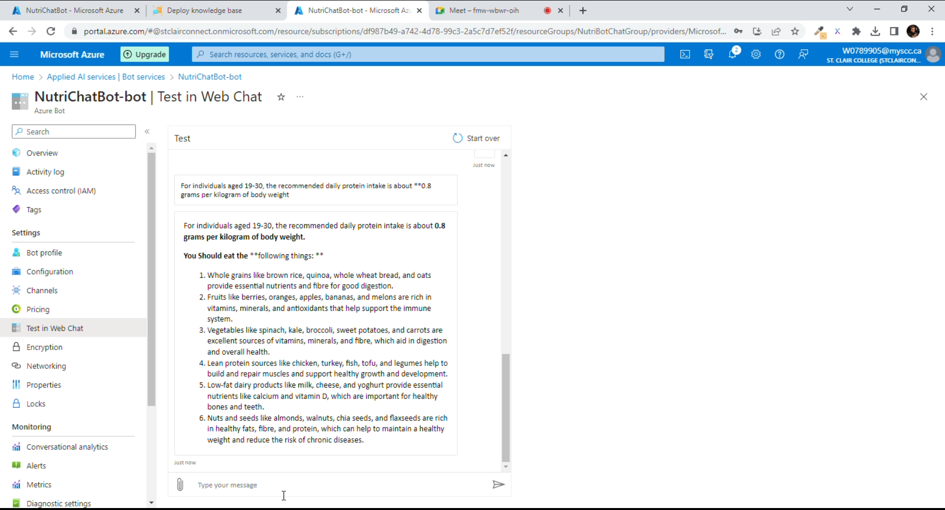
Here is a use case,

Slide 10
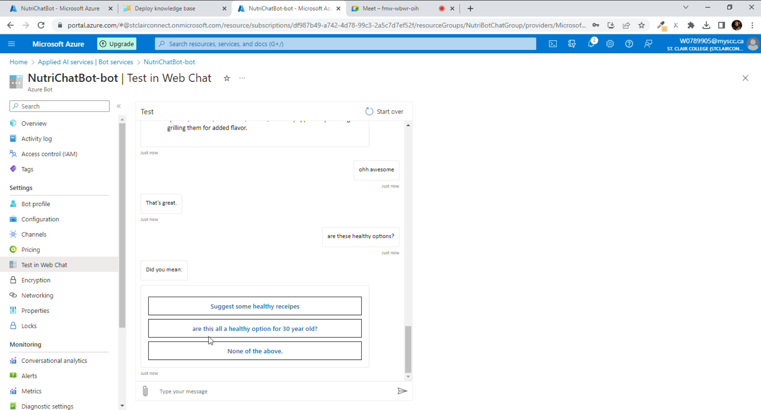
Here is a use case,

Slide 11
Expected Results Based on the information provided by her
Based on the information provided by her, this chatbot recommends a personalized meal plan that includes breakfast, lunch, dinner, and snacks.
The chatbot also suggests healthy recipes that she can try based on her dietary preferences and age.
It also provides her with nutritional information for each food item, such as calorie count, vitamin, and mineral content.
With the help of this chatbot, she can plan and prepare healthy meals that align with her goals and preferences.
She is also more aware of portion sizes and nutritional information, which helps her make better choices when dining out or grocery shopping. Over time, she can lose weight and improve her overall health and well-being

Slide 12
Expected Results
Here are few more potential use cases:
Fitness Freaks: People who are interested in fitness and exercise may want to use this chatbot to help them plan meals that support their training goals. For example, they may want to build muscle or increase endurance, and the chatbot can provide them with meal plans that align with those goals.
Parents: Parents who want to ensure that their children are eating a healthy and balanced diet may use this chatbot to get ideas for kid-friendly meals and snacks. The chatbot can consider any dietary restrictions or allergies and provide meal options that are both nutritious and appealing to children.
Seniors: Older adults who may be on fixed incomes or have limited mobility may benefit from the chatbot's meal planning. The chatbot can help them plan meals that are affordable and easy to prepare, while also considering any dietary restrictions or health concerns.

Slide 13
Results

Slide 14
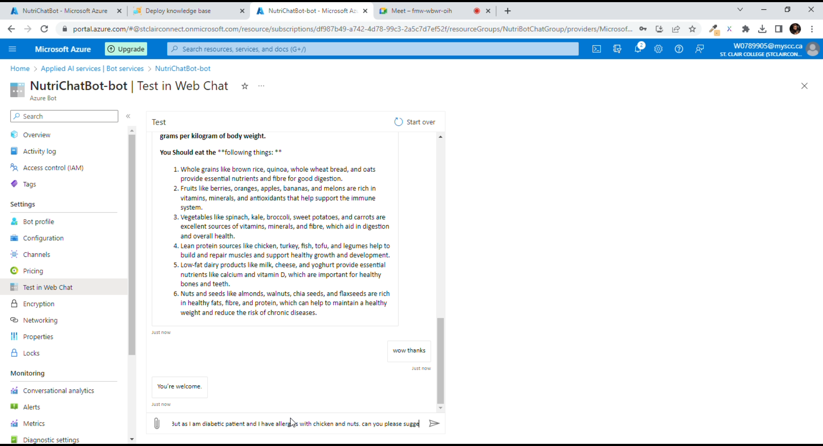
Results

Slide 15

Video about how it works,

Slide 16
Limitations
Reliance on user input
Lack of personalization
Limited scope
Limited understanding of cultural differences
Lack of data

Slide 17
Failures☹ & Challenges ☺
Our chatbot name is NutriCoach. In language studio, somehow it is not accepting this name as a project name and throwing a server error continuously. So we changed the name in the language studio.
From two accounts, which we were using for other AI projects and chatbots, it was not allowing us to deploy in web and continuously throwing an error for "You exceed free limits." So we took a fresh account from one of our team members, and it works.
Training a chatbot was a difficult part for us because the information people provide may vary from person to person.

Slide 18
Opportunity for Improvements
There is always room for improvement in any project, and this includes the following specific scenarios:
Gathering more data:
In order to create a more effective chatbot for personalized nutritional guidance and meal planning, it is important to collect as much relevant data as possible. This could include information about a user's dietary preferences, health goals, and daily routine. By gathering this data, the chatbot can make more informed recommendations that are tailored to the user's individual needs.
Refining our algorithms:
As the chatbot interacts with users and gathers more data, it is important to continually refine its algorithms. This involves analysing the data and making adjustments to the chatbot's decision-making process. By refining the algorithms, the chatbot can provide more accurate and personalized recommendations to users.
Improving the user experience:
In order to keep users engaged and motivated to use the chatbot, it is important to continually improve the user experience. This could include updating the chatbot's interface to make it more intuitive and user-friendly, adding new features that enhance the user experience, and providing regular feedback and guidance to users.

Slide 19
Additional Recommendations To further improve the chatbot could include:
The chatbot can be improved by offering users a weekly schedule of meals and snacks to plan ahead and stay on track with their dietary goals.
Keeping a record of user interactions to achieve a more personalized experience and a personalized health schedule for each user.
Providing meals based on BMI (Body Mass Index)

Slide 20
Ethical Implications of AI
Artificial Intelligence has revolutionized the world in which we live as well as various aspects of our life, ranging from healthcare to education, and from entertainment to transportation. Furthermore, as a technological platform, AI may automate labor-intensive occupations or create new ones that allow humans to be usefully employed.
It’s now nearly hard to picture a world without AI since it has become so ubiquitous. However, there are several concerns that come with the increased use of AI. The present trend in AI development is towards further automation, yet doing so may entail passing up the opportunity to create the ‘right’ kind of AI, which has superior economic and societal results.
Ethical Implications of AI: In recent months, AI technology has made significant progress, including in artistic professions such as Dall-E, and in the form of the popular language model, ChatGPT. However, concerns have been raised about the authenticity of AI-generated content, with reports of children using ChatGPT to cheat on assignments. Copyright ownership is also a contentious issue in the media sector. Furthermore, there are ethical implications of AI, including potential job loss and issues with accountability and transparency. Governments, regulatory agencies, tech businesses, researchers, and the public all have roles to play in ensuring that AI is developed and used ethically.
Ethical Implications of AI in Healthcare Sector
Real life ramifications of AI

Slide 21
Thank You ☺

